Slide 1
Dissertation Learning to fear social interactions: Dysregulated neural mechanisms of social learning in adolescent social anxiety
By
Tessa Clarkson

Slide 2

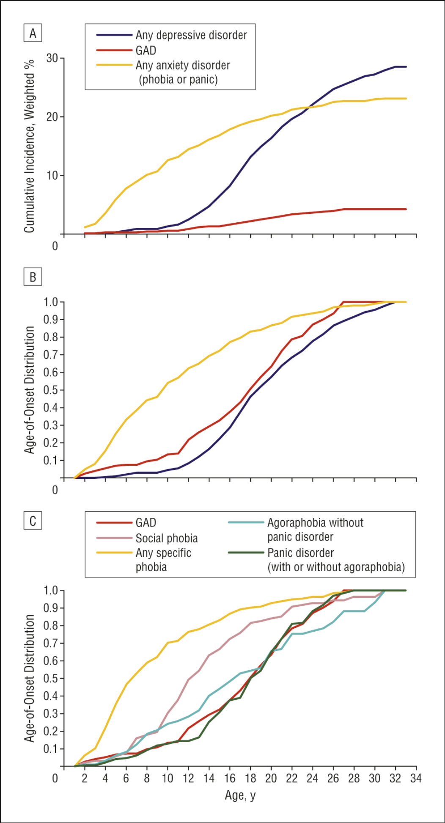
Social Anxiety Disorder
Percent of Patients
Age of Onset
Social Anxiety disorder (SAD) is prevalent (Kessler 2005), chronic (Beedso), and highly detrimental to quality of life (Wittchen 1996; Stein 2000).
Notes:
SAD is characterized by intense fear and anxiety of being judge, negatively evaluated or rejected in social situations
Social anxiety disorder (SAD) is prevalent (Kessler et al., 2005), chronic (Beesdo-Baum et al., 2012), and highly detrimental for quality of life (Stein & Kean, 2000; Wittchen & Beloch, 1996).
Though incidence for anxiety disorders increase in adolescents, it is particular true for SAD given the increase in importance in peer relationships

Slide 3
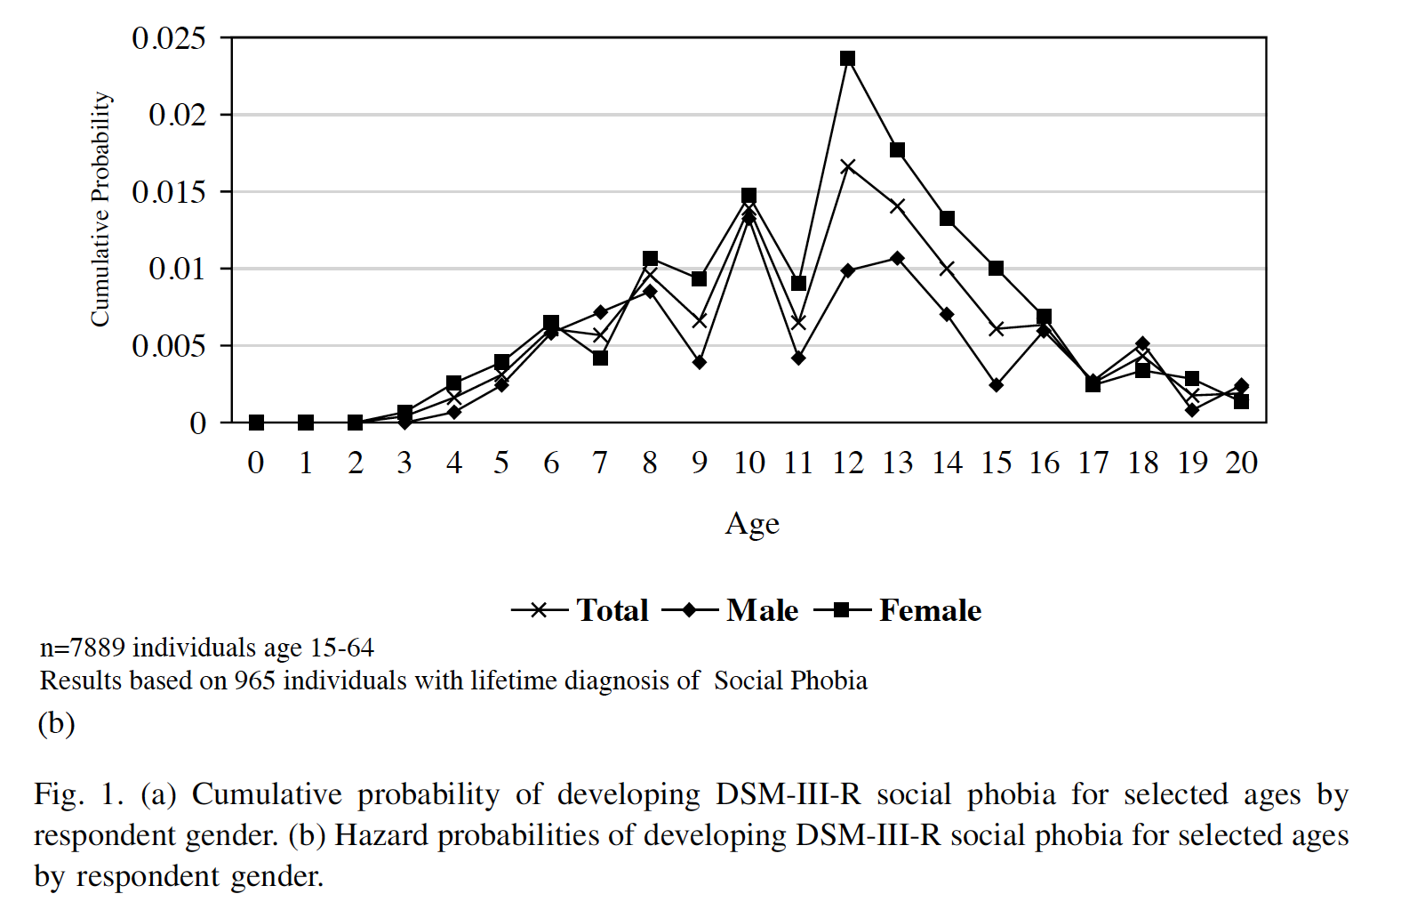
Highest incidence rates between ages 10-15
(DeWit et al., 2005)
Notes:
between the ages of 11-15 we see dramatic increases in SAD (DeWit et al., 2015)--making this time period critical for studying how adolescents learn to fear social evaluation
Yet, little is known about how adolescents with SAD learn to fear social evaluation from their peers—a hallmark symptom of SAD.

Slide 4
Target Social Learning
Adaptive learning in different social contexts, that vary in valence and predictability, may be crucial for youth to adjust to rapidly changing adolescent social interactions
Regions in the salience, reward and cognitive control networks associated with social learning are altered in SA
Difficulties in behavioral and neural mechanisms of social learning may lead to social anxiety (SA)
Use computational modeling & fMRI
Valence & Predictability of Peer Reputation
Valence of Peer feedback
Weight of unexpected outcomes vs existing estimation of reputation (Associative value)

Slide 5
Participants

Slide 6
Social Anxiety Measures
ADIS Combined Parent and Child Diagnoses
SCARED- child self-report social anxiety subscale
Clinically cut-off is 8
In our sample 7 or greater corresponded to Dx on ADIS
We used SA continuous measure for all analyses and then cut-off of 7 for decomposition visualizations and group comparisons.

Slide 7
Aims
Aim 1. A) Compared reinforcement learning models, associative value models, and combined models in social contexts that vary in their predictability and valence to understand differences in social learning among adolescents with a full range of SA symptoms.

Slide 8
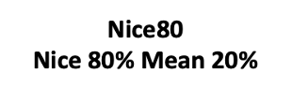
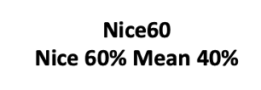
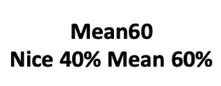
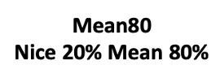
LEARN Task

Slide 9
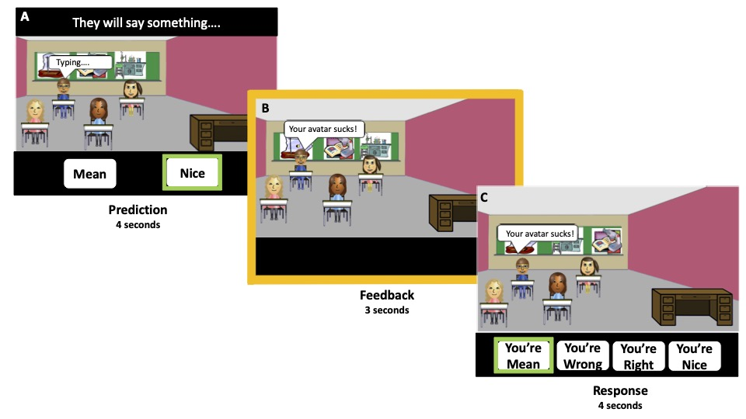
LEARN Task
Figure 1. LEARN Task. Each social interaction trial includes portions A-C followed by an inter-trial interval.

Slide 10
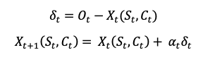
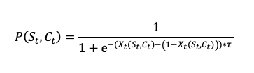
Computational Models
All Models:
RL framework and softmax
Optmin function,
initialized parameters at .5,
MAP to optimize parameters
0
1

Slide 11
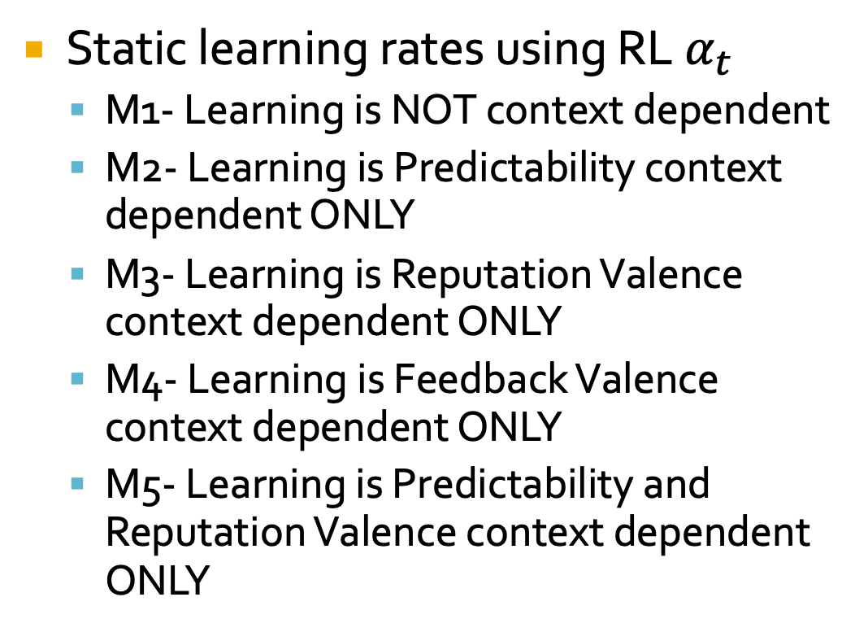
Models 1-5
Static learning rates using RL $α_{t }$
M1- Learning is NOT context dependent
M2- Learning is Predictability context dependent ONLY
M3- Learning is Reputation Valence context dependent ONLY
M4- Learning is Feedback Valence context dependent ONLY
M5- Learning is Predictability and Reputation Valence context dependent ONLY

Slide 12
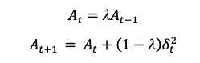
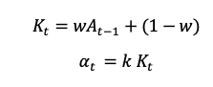
Models 6-10
Models dynamically adjust learning rate based on the attention allocated to the prediction error (i.e. unexpected positive or negative feedback)
Follow the same M1-5 models examining context-dependent factors (i.e. predictability and valence of reputation and feedback)

Slide 13
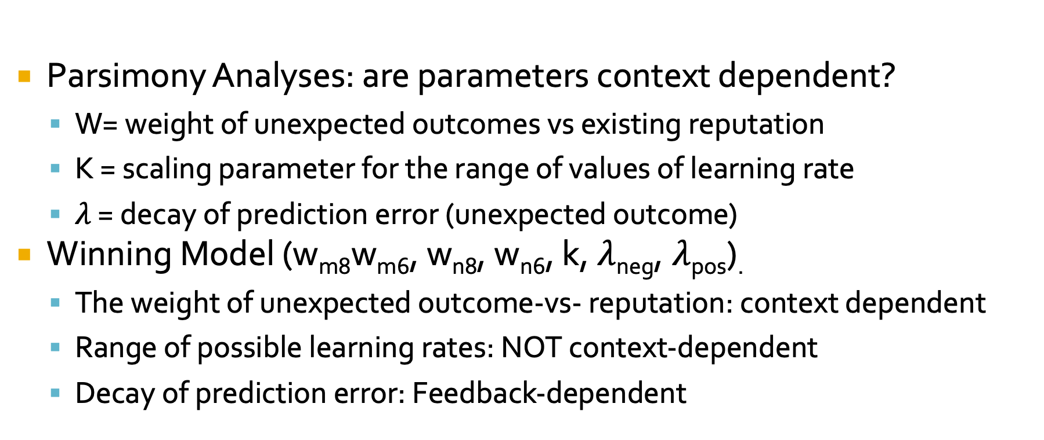
Parsimony Analyses
Parsimony Analyses: are parameters context dependent?
W= weight of unexpected outcomes vs existing reputation
K = scaling parameter for the range of values of learning rate
$λ$ = decay of prediction error (unexpected outcome)
Winning Model (w_{m8}w_{m6}, w_{n8}, w_{n6}, k,$λ$_{neg},$λ$_{pos}).
The weight of unexpected outcome-vs- reputation: context dependent
Range of possible learning rates: NOT context-dependent
Decay of prediction error: Feedback-dependent

Slide 14
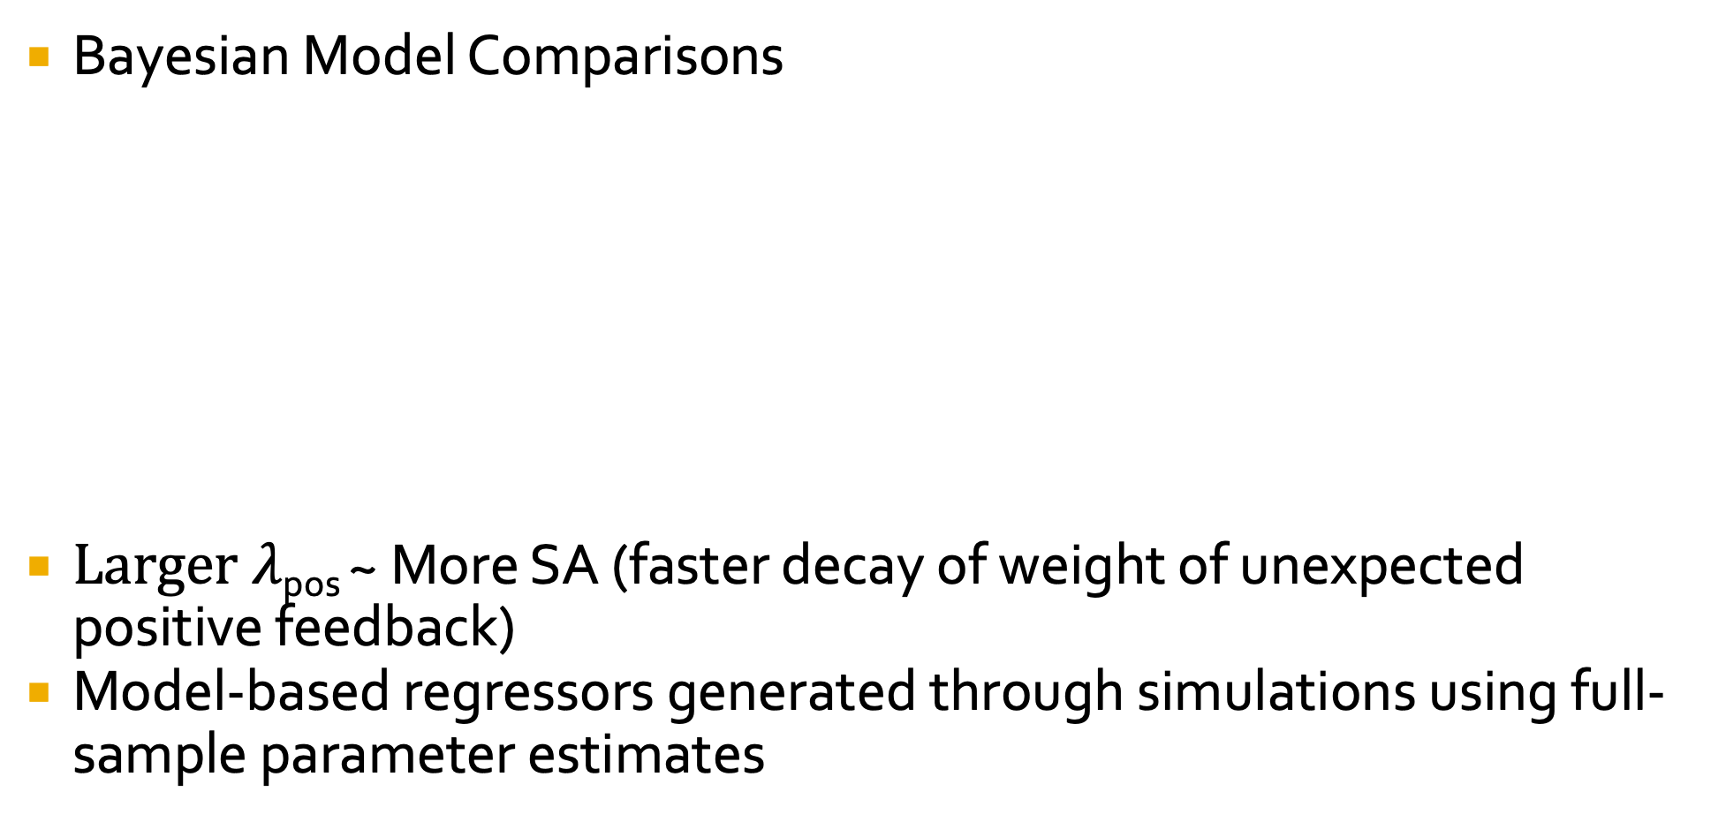
Computational Model Comparison
Bayesian Model Comparisons
$Larger λ$_{pos} ~ More SA (faster decay of weight of unexpected positive feedback)
Model-based regressors generated through simulations using full-sample parameter estimates

Slide 15
Behavioral & Modeling Results
Social learning is context dependent and varies by SA
SA
accurate estimation of peer reputations.
Non-SA
positivity bias in estimating peer reputations.
Model reproduces behavior

Slide 16
A
B
Mechanisms of social learning are context dependent and varies by SA
SA
learned rapidly and dynamically in predictably nice and unpredictable social contexts by allocating more weight to unexpected negative-vs-positive feedback.
Non-SA
learned slowly in all social contexts, and dynamically adjusted learning in unpredictable social contexts by allocating weight to unexpected negative and positive feedback.

Slide 17
Summary of Behavioral Mechanisms
Aim 1. A) Compared reinforcement learning models, associative value models, and combined models in social contexts that vary in their predictability and valence to understand differences in social learning among adolescents with a full range of SA symptoms.
Social learning is context dependent and varies by SA
SA
learned rapidly and dynamically in predictably nice and unpredictable social contexts by allocating more weight to unexpected negative-vs-positive feedback.
accurate estimation of peer reputations.
Non-SA
learned slowly in all social contexts, and dynamically adjusted learning in unpredictable social contexts by allocating weight to unexpected negative and positive feedback.
positivity bias in estimating peer reputations.

Slide 18
Summary of Modeling Results
Low SA | Slow LR Weigh Reputation Pos bias | Slow LR Weigh PE Pos bias | Slow LR Weigh Reputation Pos bias | Slow LR Weigh PE Pos bias
High SA | Slow LR Weigh Reputation Accurate Discount pos PE | Fast LR Weigh PE Accurate Discount pos PE | Fast LR Weigh PE Accurate Discount pos PE | Fast LR Weigh PE Accurate Discount pos PE

Slide 19
Aims
Aim 2. Determine neural activation evoked by social learning during social feedback and relations social contexts and SA.

Slide 20
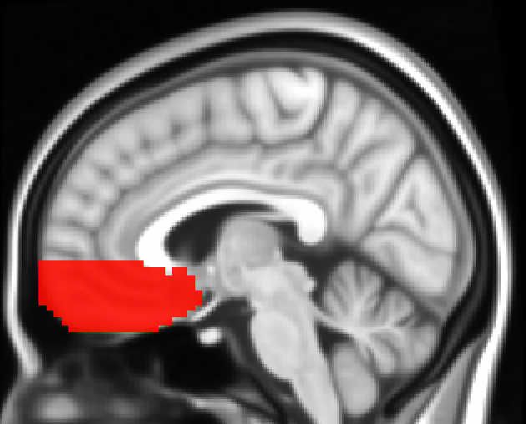
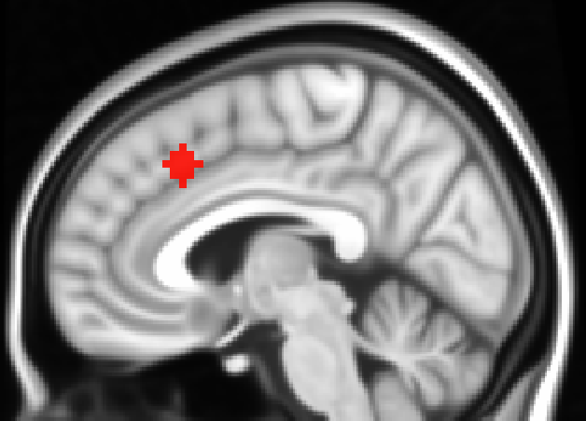
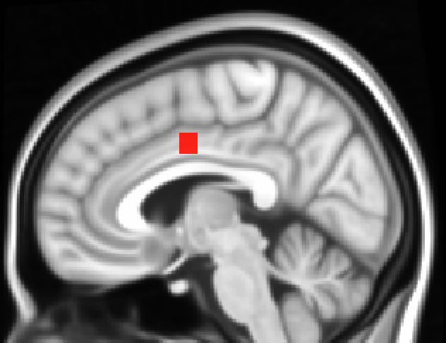
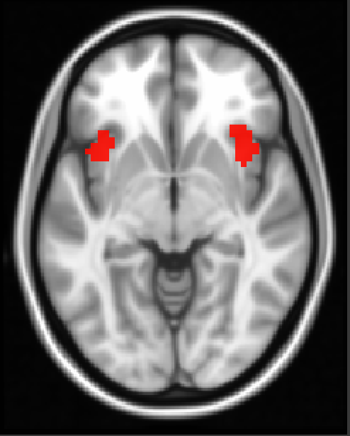
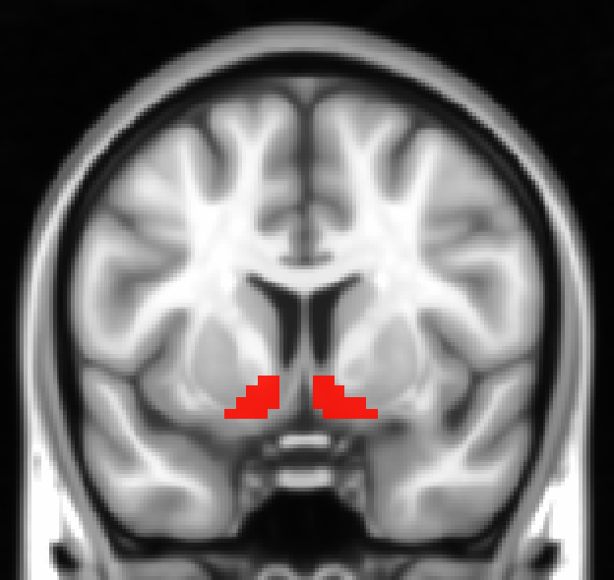
A
B
C
x= -3
x= -5
x= -5
D
E
z= -4
x= -11
Cognitive Control
Salience
Reward
Figure 2. Apriori Network Mask Sub-regions. Bilateral- A) vmPFC, B) anterior dACC, C) posterior dACC, D) anterior insula, E) ventral striatum

Slide 21
Imaging Analyses
Parametric Modulation with Model-based Prediction Errors:
reputation-based prediction-error
positive values indicate nicer than expected feedback,
negative values indicate meaner than expected feedback,
accuracy-based prediction-error
positive values indicate feedback in the direction predicted,
negative values indicate feedback in the opposite direction predicted,
Group-Level 3dMVM: Predictably x Reputation Valence x SA during Feedback (prediction error occurs)
Notes:
-can model other epochs-but not aim of this grant.

Slide 22
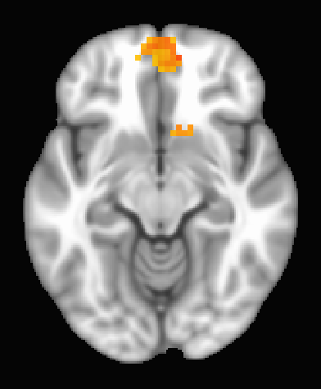
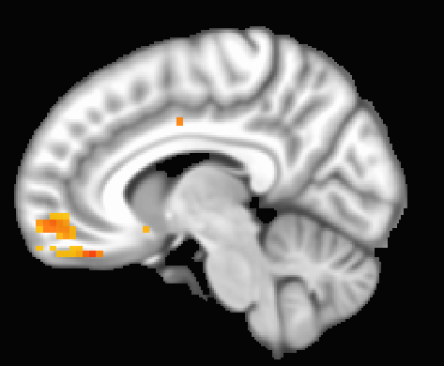
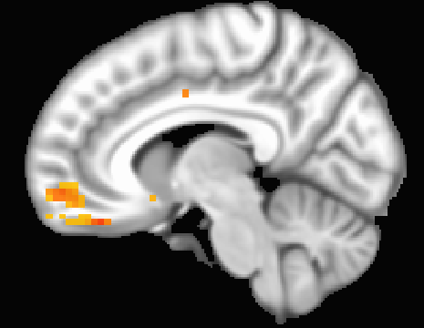
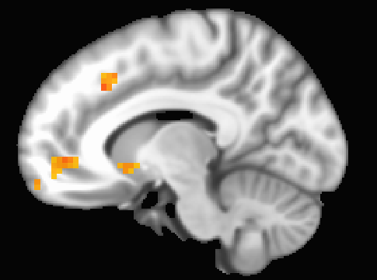
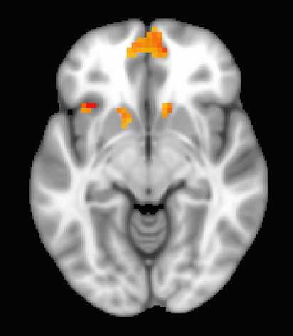
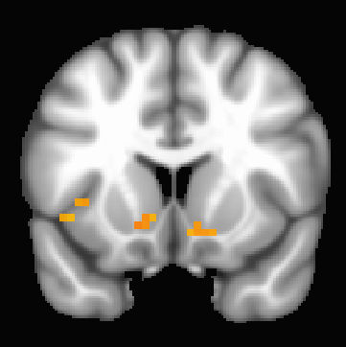
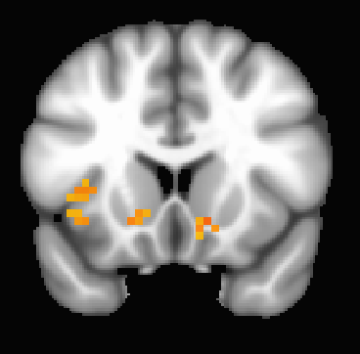
A
B
C
D
z= -10.5
x= -7.5
x= 10.5
x= -7.5
E
F
G
z= -7.5
y= -13.5
y= -16.5
Figure 5. Significant Clusters Reputation-Based Prediction Error: Valence by Predictability by SA. A) bilateral vmPFC, B) right vmPFC, C) Left Anterior dACC, D) Right Posterior dACC, E) Left Anterior Insula F) Left Ventral Striatum, G) Right Ventral Striatum

Slide 23
Imaging Results

Slide 24
Bilateral vmPFC
More severe SA:
decreased brain activation to unexpected negative feedback
predictably nice
unpredictably mean (vmPFC only)
increased in brain activation to unexpected positive feedback
predictably mean
Effect Size of Reputation-Based
Prediction-Error on Mean Activation
Social Anxiety
(Centered at Clinical/diagnostic cutoff of 7)
Reputation Valence
Nice
Mean
Notes:
Talk about accuracy model as NS
and cognitive control only unpredictable mean

Slide 25
Bilateral vmPFC
Effect Size of Reputation-Based
Prediction-Error on Mean Activation
Brain Activation ~ neg PEs (meaner than expected)
Decreased Brain Activation ~ More severe SA
Brain Activation ~ pos PEs (nicer than expected)
Increased Brain Activation ~ More severe SA
Social Anxiety
(Centered at Clinical/diagnostic cutoff of 7)
Reputation Valence
Nice
Mean
Notes:
Talk about accuracy model as NS
and cognitive control only unpredictable mean

Slide 26
Summary of Imaging Results
Low SA | ~ pos PE ⬇️ Brain Activation Salience, Reward, Cog Control | ~ neg PE ⬆️ Brain Activation Cog Control | ~ neg PE ⬆️ Brain Activation Salience, Reward, Cog Control | ~ pos PE ⬇️ Brain Activation Salience, Reward, Cog Control
High SA | ~ pos PE ⬆️ Brain Activation Salience, Reward, Cog Control | ~ neg PE ⬇️ Brain Activation Cog Control | ~ neg PE ⬇️ Brain Activation Salience, Reward, Cog Control | ~ pos PE ⬆️ Brain Activation Salience, Reward, Cog Control

Slide 27
Summary of Neural Mechanisms
Aim 2. Determine neural activation evoked by social learning during social feedback and relations social contexts and SA.
more severe SA symptoms:
decreased brain activation to unexpected negative feedback in predictably nice and unpredictably mean social contexts
increased in brain activation to unexpected positive feedback in predictably mean social contexts

Slide 28
Real World Implications
Youth with SA learn differently in social contexts
Unpredictable Contexts:
More reactive to unexpected outcomes
ONLY engaged cognitive control regions
Predictable Positive Contexts:
Reactive to unexpected negative outcomes
Faster decay of unexpected positive feedback ~ severity
decreased engagement of salience, reward and cognitive control regions
Treatment:
Focus on waiting to make judgements (sit with uncertainty)
Increase attention to, and rewarding nature of positive feedback
Improve recall of positive feedback

Slide 29
Future Goals
Company
Generate person-specific ML algorithms to estimate individual social learning styles
Apps, phone, texting opt-ins
Use clinically trained ML individualized suggestions to improve social learning and communication
Metrics to understand learning style and changes/improvements
Next steps: Generate Proposal for VC firms

Slide 30
Thank you!
Graduate School Advisors:
Drs. Johanna Jarcho, Matthew Lerner, & Phil Kendall
Dissertation Mentors:
Drs. Johanna Jarcho, Leor Hackel, David Barack
Dissertation Committee:
Drs. Johanna Jarcho, Tom Olino, Phil Kendall, Leor Hackel, Matthew Lerner, & Jason Chein
Research Team:
Megan Quarmley, Camille Johnston, & Alisha Arora

Slide 31
A
Bilateral vmPFC
B
Right vmPFC
E
Left Anterior Insula
*
*
*
*
**
C
Left Anterior dACC
D
Right Posterior dACC
Valence
Nice
Mean
Effect Size of Reputation-Based Prediction-Error on Mean Activation
*
F
Left Ventral Striatum
G
Right Ventral Striatum
*
*
**
Social Anxiety: Centered at 7
Figure 6. Decomposition of Reputation-Based Prediction Error: Valence by Predictability by SA within Activation Clusters.
Notes:
decreased brain activation to unexpected negative feedback in predictably nice and unpredictably mean social contexts
increased in brain activation to unexpected positive feedback in predictably mean social contexts

